Slide 1

Preparation for Lab 4
Week 8
Semester 1, 2025
Dr. Farshid Keivanian

Slide 2
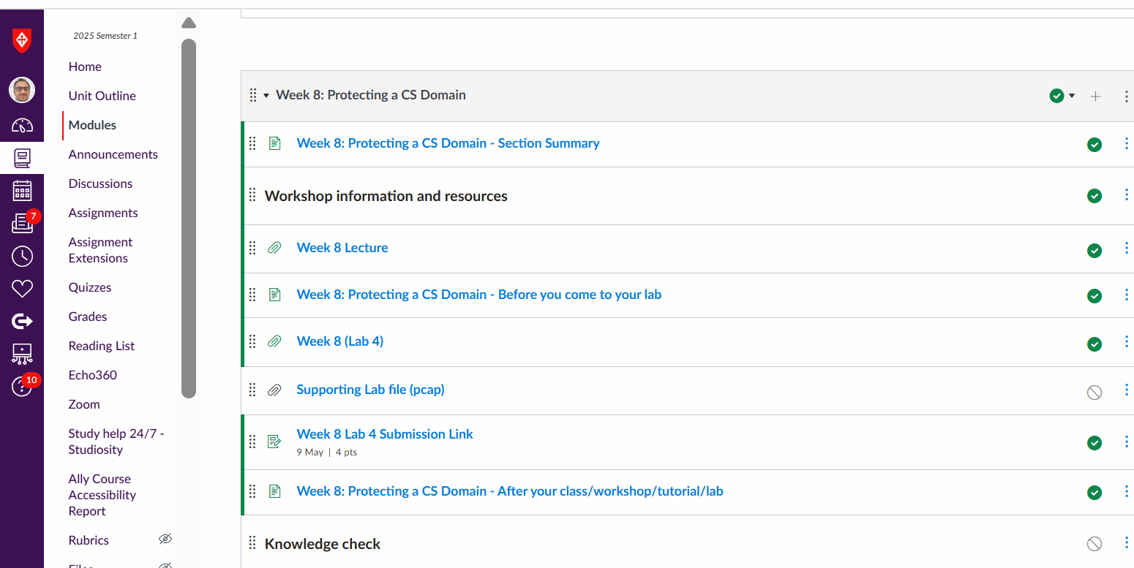
Preparation for Lab 4 (Week 8)
Navigate Canvas >> Week 8 >> Lab 4

Slide 3
Introduction
Welcome to Lab 4! This week, we're putting together important parts of cybersecurity like puzzle pieces:
Hash Functions = Making data fingerprints
Digital Signatures = Making online signatures for proof
ElGamal Signature = How real-world secure messaging works
OpenSSL Hashing = Hands-on with tools hackers and defenders both use!

Slide 4
Introduction
Think of this lab like building security locks:
Hashing = fingerprint locks
Digital signatures = handwritten signatures
OpenSSL = your real-world toolkit

Slide 5
Goals and What You Will Learn
By the end of Lab 4, you will:
Understand what makes a good hash function
Understand preimage attacks and birthday attacks
Learn how digital signatures protect data
Perform ElGamal signature creation and verification
Use OpenSSL to hash and observe how tiny changes break security
Build critical cyber defense skills!

Slide 6
Theory Background
1. Hash Functions
They convert any data into a unique fixed-length code (like a fingerprint).
Good hash functions should be:
Fast
Hard to reverse
Collision-resistant (two messages shouldn’t have the same hash)

Slide 7
Theory Background
2. Preimage Attack
Trying to find a message that matches a given hash.
For a good n-bit hash, you need about 2ⁿ tries.
(e.g., 2¹²⁸ for a 128-bit hash!)

Slide 8
Theory Background
3. Birthday Attack
Just like in a class, where two people might share a birthday surprisingly quickly.
In cybersecurity, it means finding two messages that hash to the same value.
Needs about 2ⁿ/ ² tries.

Slide 9
Theory Background
4. Digital Signatures
Prove who sent a message and that it was not changed.
Example: Signing an online contract via DocuSign.
Properties:
Authenticity (you really sent it)
Integrity (unchanged)
Non-repudiation (you can’t deny it later)

Slide 10
Theory Background
5. ElGamal Digital Signature
Uses math magic (modular arithmetic) to create a signature.
Others can verify the signature without seeing your private key!

Slide 11
Lab 4 Structure and Step-by-Step Instructions
Part 1: Theory Questions (Written Answers)
List and explain key requirements of a hash function.
Calculate effort needed for preimage attack (half success).
Explain birthday attack and effort needed (half success).
List applications and properties of digital signatures.
Briefly explain ElGamal signature generation and verification.
Goal: Strengthen your understanding of core concepts.

Slide 12
Lab 4 Structure and Step-by-Step Instructions
Part 2: Challenge Exercise – ElGamal Digital Signature
You are given:
Public Key = {q = 13, a = 2, YA = 8}
Private Key = {XA = 3}
Message = {M = 11}
Random K = 5
Goal: Generate and verify a digital signature.

Slide 13
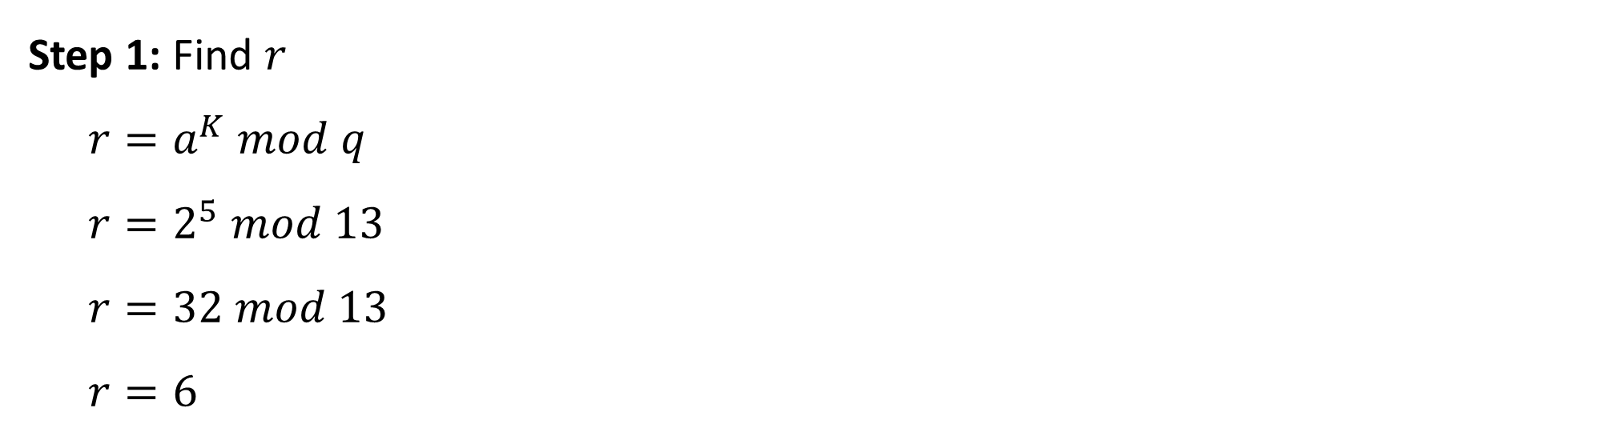
Lab 4 Structure and Step-by-Step Instructions
Step 1: Find $r$
$r=a^{K} mod q$
$r=2^{5} mod 13$
$r=32 mod 13$
$r=6$

Slide 14
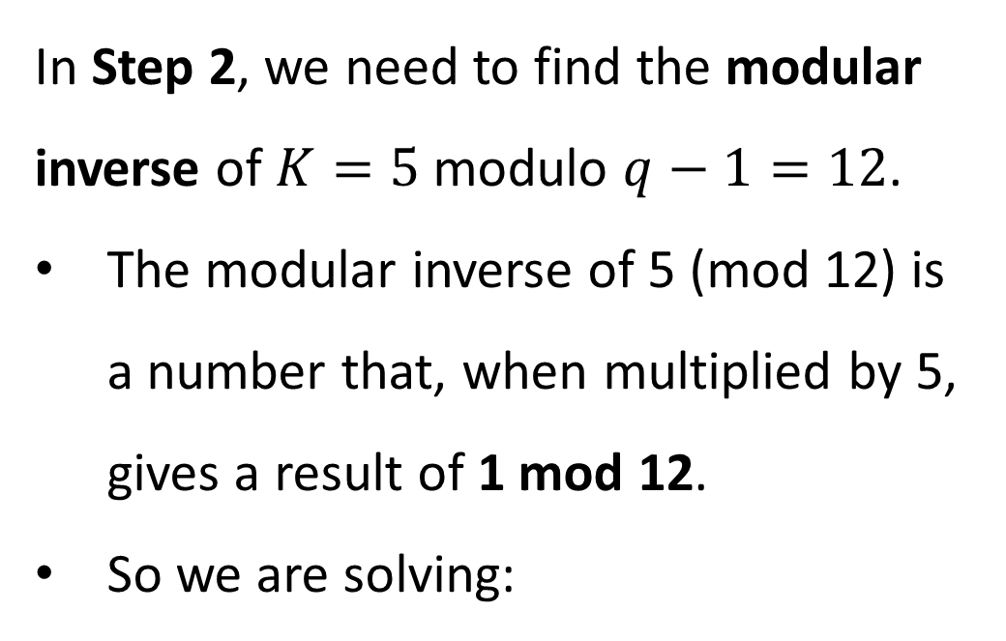
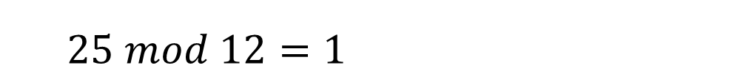
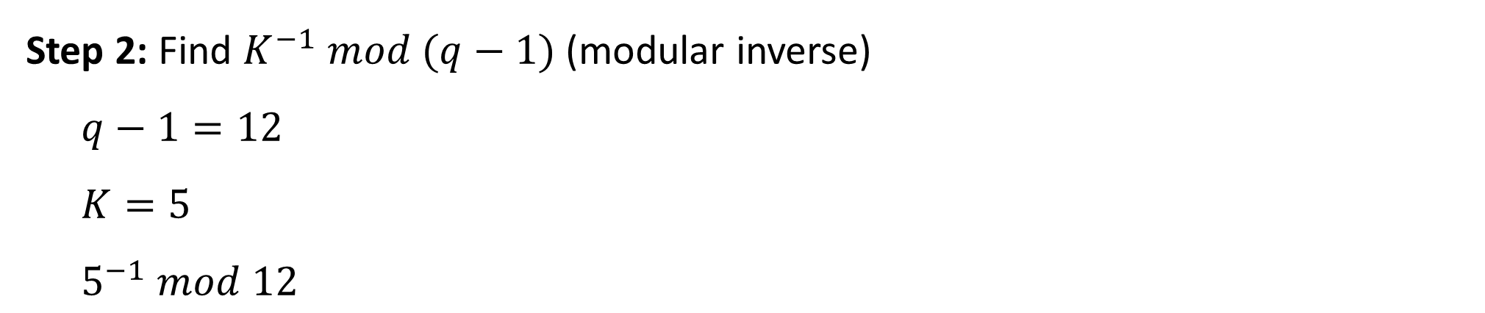
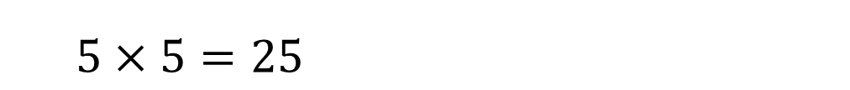

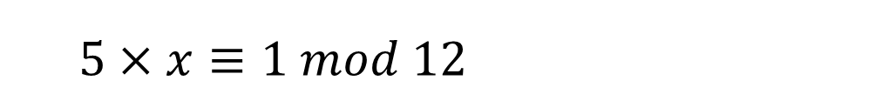
Lab 4 Structure and Step-by-Step Instructions
Step 2: Find $K^{−1} mod (q−1)$ (modular inverse)
$q−1=12$
$K=5$
$5^{−1} mod 12$
In Step 2, we need to find the modular inverse of $K=5$modulo $q−1=12$.
The modular inverse of 5 (mod 12) is a number that, when multiplied by 5, gives a result of 1 mod 12.
So we are solving:
$5×x≡1 mod 12$
When we try $x=5$ :
$5×5=25$
$25 mod 12=1$

Slide 15
Lab 4 Structure and Step-by-Step Instructions
Step 2: Find $K^{−1} mod (q−1)$ (modular inverse)
$q−1=12$
$K=5$
$5^{−1} mod 12$
So, 5 is its own modular inverse under mod 12.
Simple analogy: It’s like asking: “What number should I multiply by 5 so that after dividing by 12, the remainder is 1?” Answer: 5 itself!
$5×x≡1 mod 12$
When we try $x=5$ :
$5×5=25$
$25 mod 12=1$

Slide 16
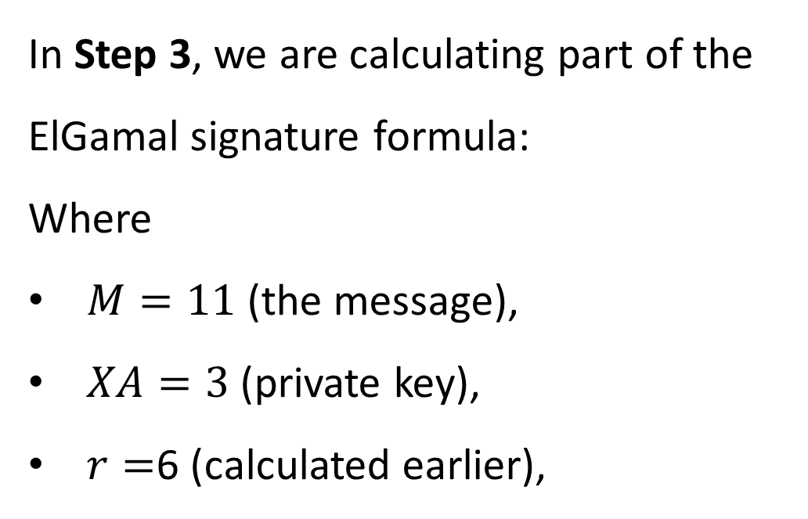
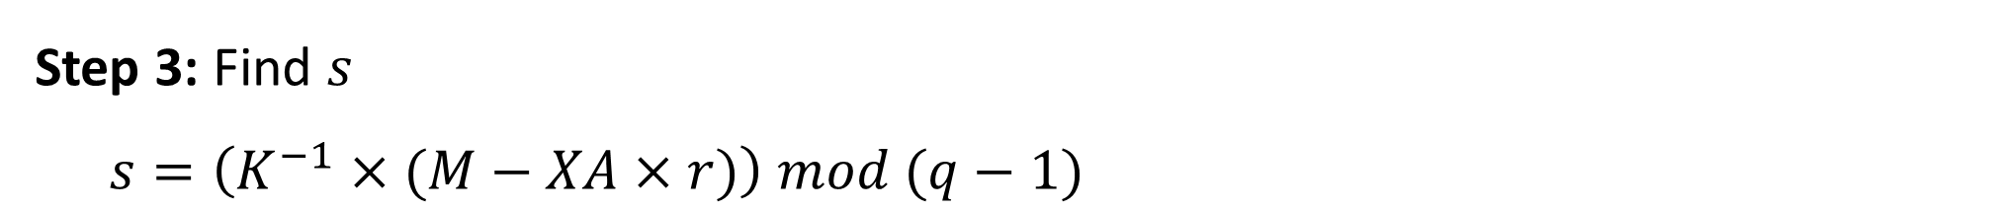
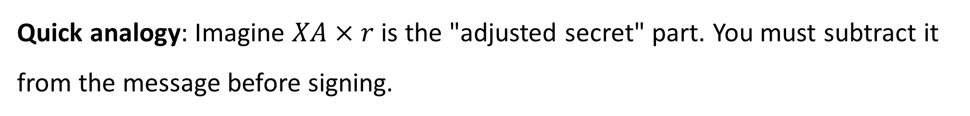
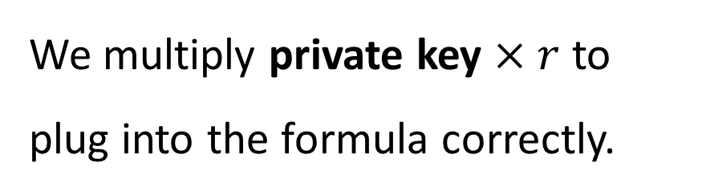
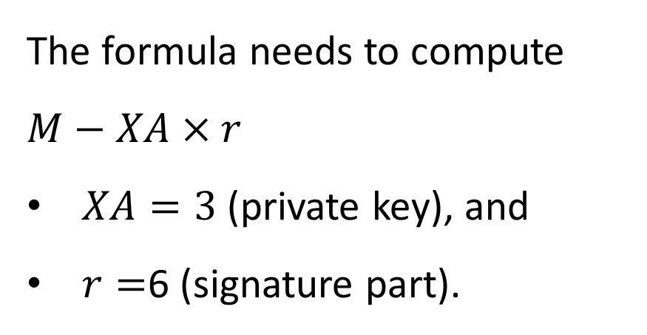
Lab 4 Structure and Step-by-Step Instructions
Step 3: Find $s$
$s=\left(K^{−1}×(M−XA×r)\right) mod (q−1)$
The formula needs to compute $M−XA×r$
$XA=3$ (private key), and
$r=$6 (signature part).
In Step 3, we are calculating part of the ElGamal signature formula:
Where
$M=11$ (the message),
$XA=3$ (private key),
$r=$6 (calculated earlier),
We multiply private key $×$ $r$ to plug into the formula correctly.
Quick analogy: Imagine $XA×r$ is the "adjusted secret" part. You must subtract it from the message before signing.

Slide 17
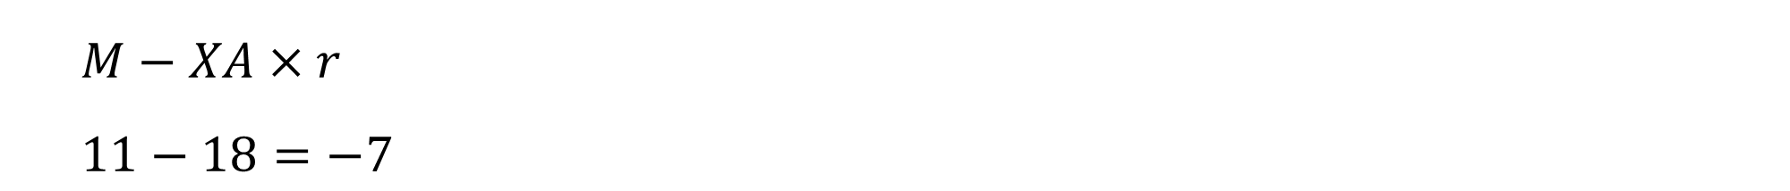
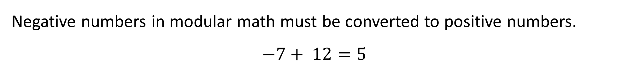
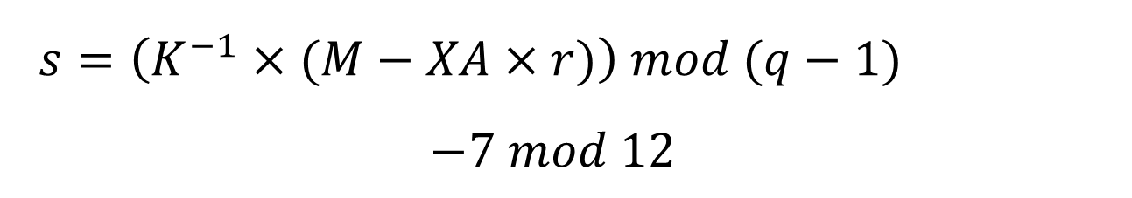
Lab 4 Structure and Step-by-Step Instructions
$M−XA×r$
$11−18=−7$
Analogy: Think of mod as wrapping negative numbers around a clock. If you’re 7 hours before 12 o'clock, you’re actually at 5 o'clock!
$q−1=12$
$s=\left(K^{−1}×(M−XA×r)\right) mod (q−1)$
$$−7 mod 12$$
Negative numbers in modular math must be converted to positive numbers.
$$−7+ 12=5$$

Slide 18
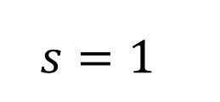
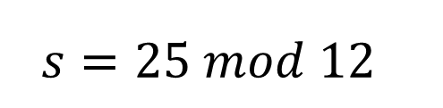
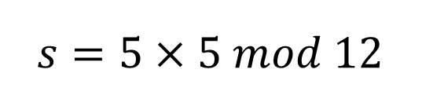
Lab 4 Structure and Step-by-Step Instructions
$K^{−1}=5 modular inverse from Step 2$
$So,$
$s=\left(K^{−1}×(M−XA×r)\right) mod (q−1)$
$$s=5×5 mod 12$$
$$s=25 mod 12$$
$$s=1$$

Slide 19
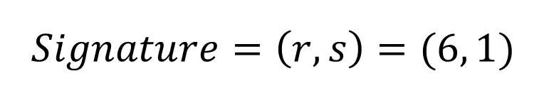
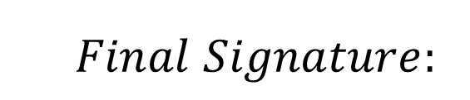
Lab 4 Structure and Step-by-Step Instructions
$$Final Signature:$$
$$Signature=\left(r, s\right)=(6, 1)$$

Slide 20
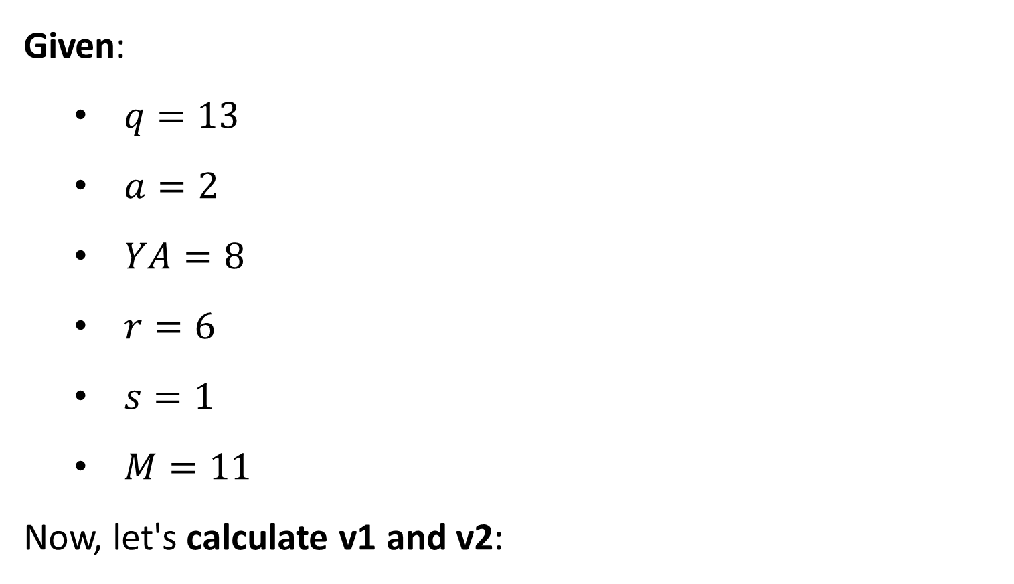

Lab 4 Structure and Step-by-Step Instructions
V$\text{erifying} \text{ElGamal} \text{Signature}\text{ (}r=6, s=1\text{)}$
Given:
$q=13$
$a=2$
$YA=8$
$r=6$
$s=1$
$M=11$
Now, let's calculate v1 and v2:

Slide 21
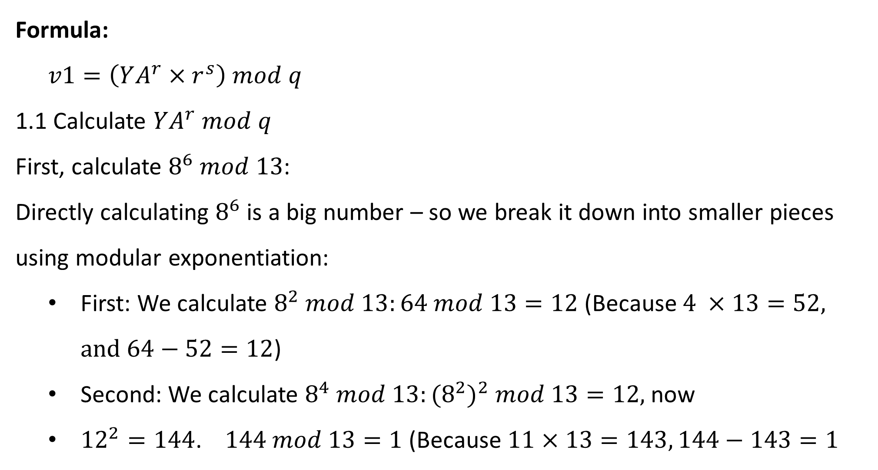
Lab 4 Structure and Step-by-Step Instructions
Formula:
$v1=\left(YA^{r}×r^{s}\right) mod q$
1.1 Calculate $YA^{r} mod q$
First, calculate $8^{6} mod 13$:
Directly calculating $8^{6}$is a big number – so we break it down into smaller pieces using modular exponentiation:
First: We calculate $8^{2} mod 13:64 mod 13=12$ (Because $4 ×13=52, and 64−52=12$)
Second: We calculate $8^{4} mod 13:{(8^{2})}^{2} mod 13=12,$now
${12}^{2}=144$. $144 mod 13=1$ (Because $11×13=143, 144−143=1$

Slide 22
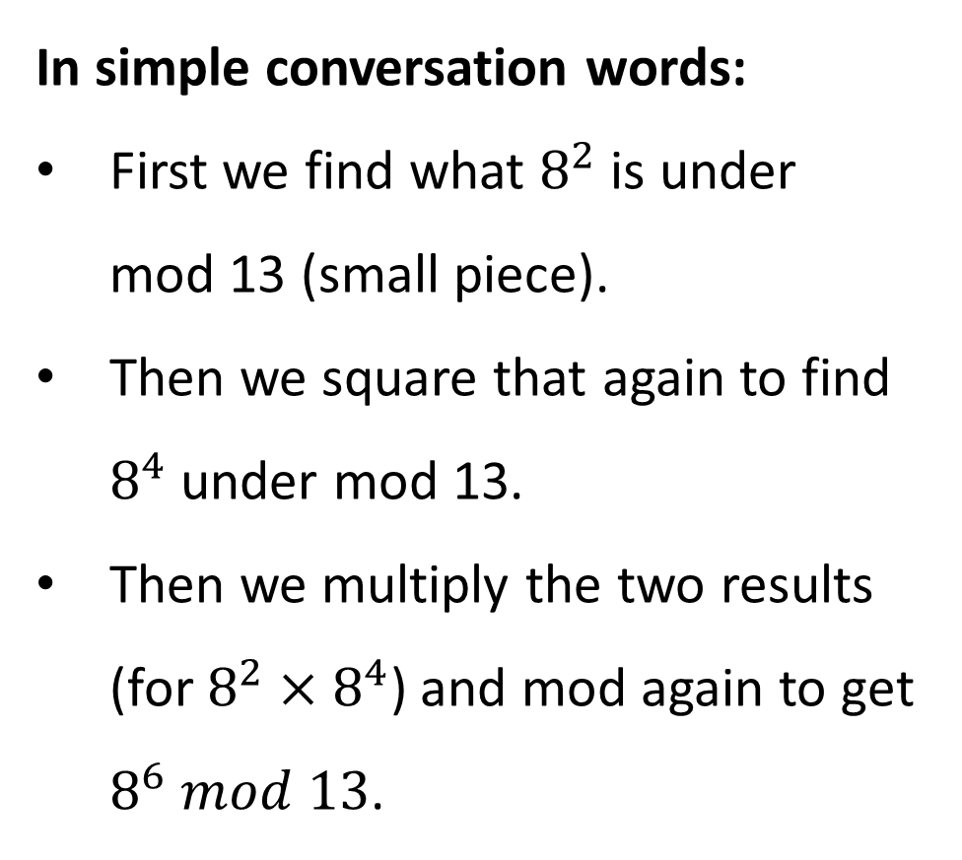
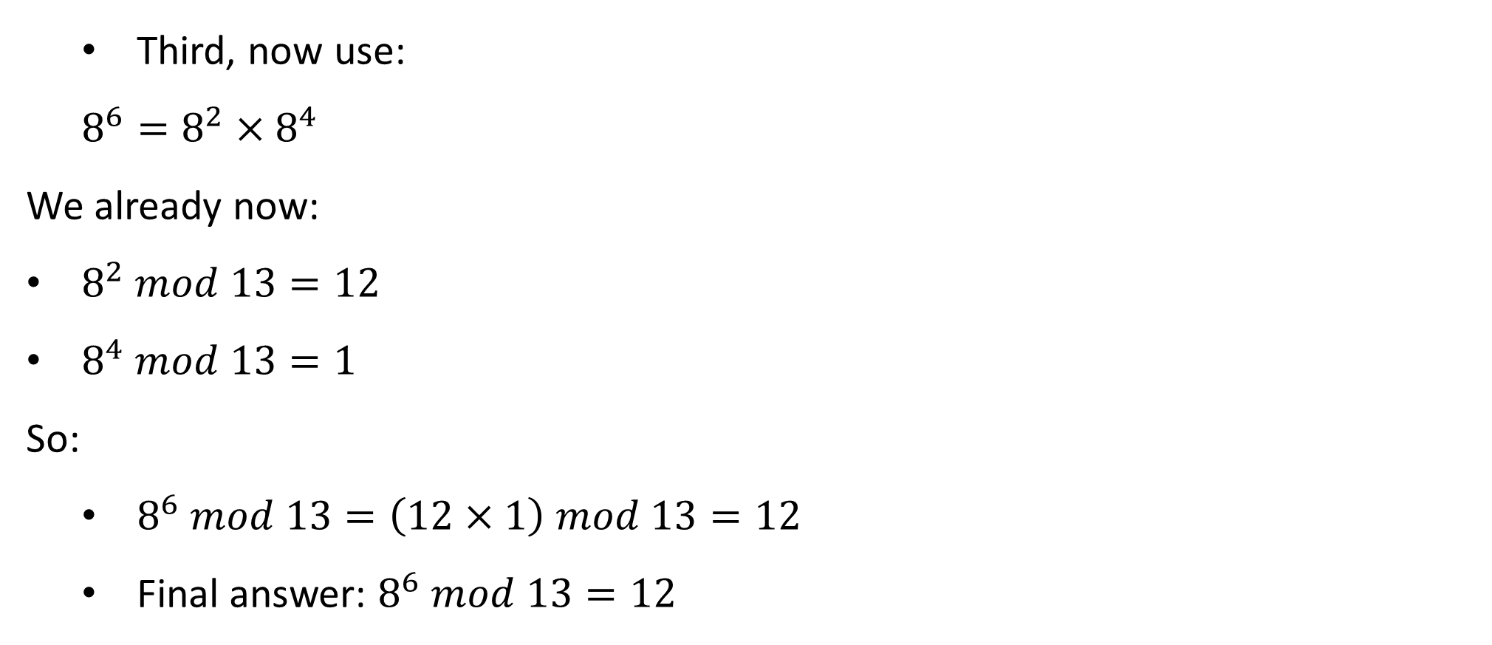
Third, now use:
$8^{6}=8^{2}×8^{4}$
We already now:
$8^{2} mod 13=12$
$8^{4} mod 13=1$
So:
$8^{6} mod 13=\left(12×1\right) mod 13=12$
Final answer: $8^{6} mod 13=12$
In simple conversation words:
First we find what $8^{2}$ is under mod 13 (small piece).
Then we square that again to find $8^{4}$ under mod 13.
Then we multiply the two results (for $8^{2}×8^{4}$) and mod again to get $8^{6} mod 13$.
Breaking powers apart like this is a trick to make life easier without huge numbers!

Slide 23
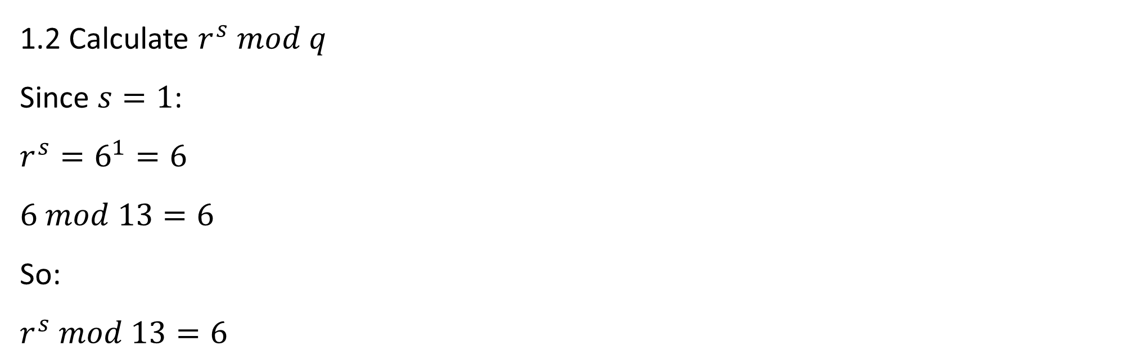
Lab 4 Structure and Step-by-Step Instructions
1.2 Calculate $r^{s} mod q$
Since $s=1$:
$r^{s}=6^{1}=6$
$6 mod 13=6$
So:
$r^{s} mod 13=6$

Slide 24
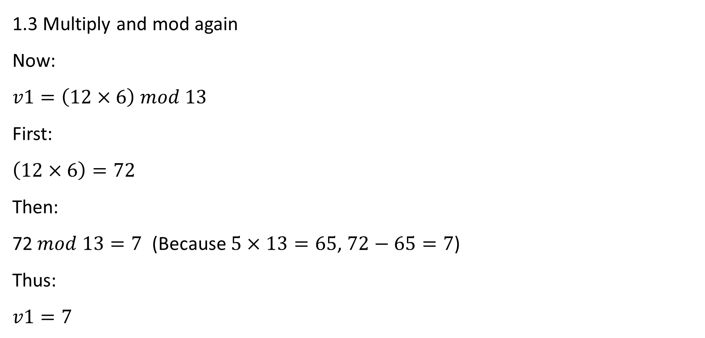
Lab 4 Structure and Step-by-Step Instructions
1.3 Multiply and mod again
Now:
$v1=\left(12×6\right) mod 13$
First:
$\left(12×6\right)=72$
Then:
72$mod 13=7$ (Because $5×13=65$, $72−65=7$)
Thus:
$v1=7$

Slide 25
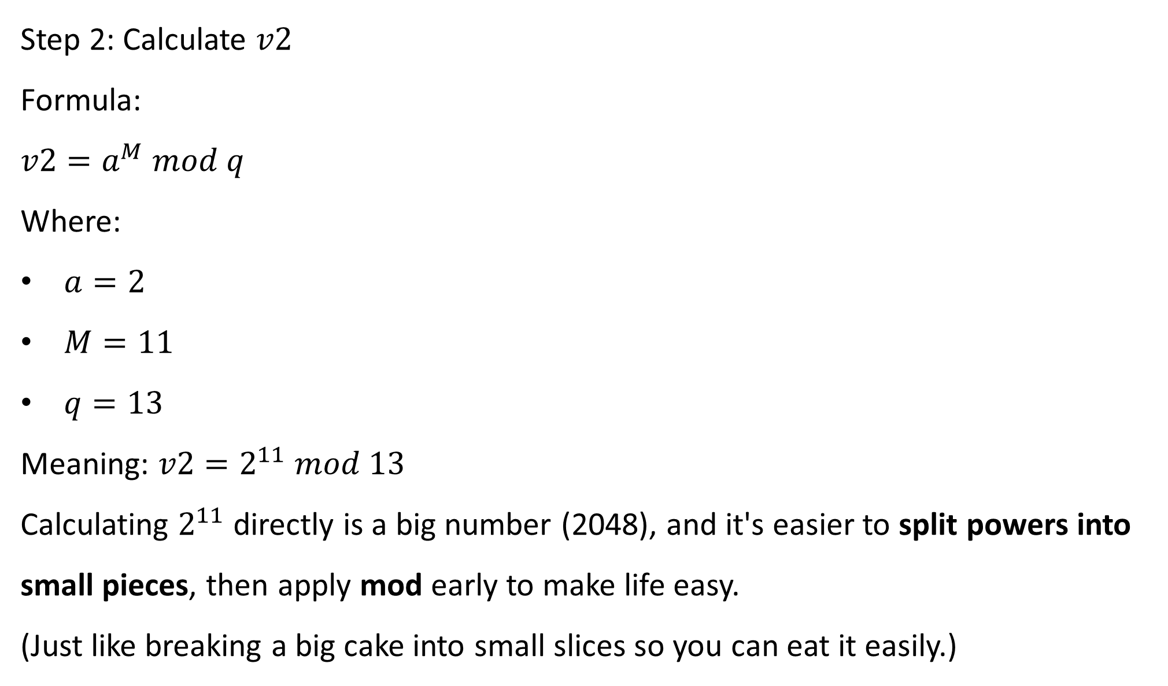
Step 2: Calculate $v2$
Formula:
$v2=a^{M} mod q$
Where:
$a=2$
$M=11$
$q=13$
Meaning: $v2=2^{11} mod 13$
Calculating $2^{11}$directly is a big number (2048), and it's easier to split powers into small pieces, then apply mod early to make life easy.
(Just like breaking a big cake into small slices so you can eat it easily.)

Slide 26
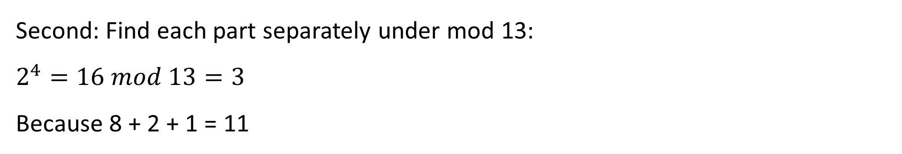
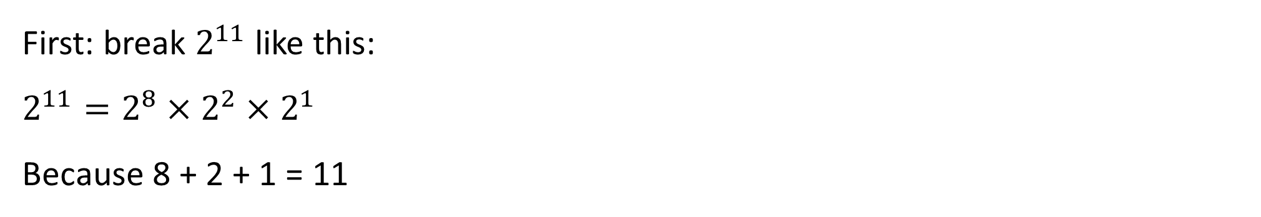
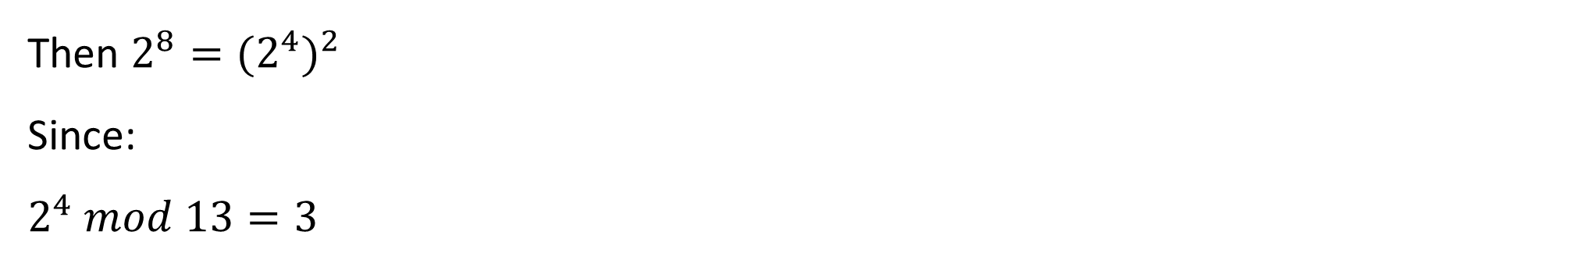
Lab 4 Structure and Step-by-Step Instructions
First: break $2^{11}$like this:
$2^{11}=2^{8}×2^{2}×2^{1}$
Because 8 + 2 + 1 = 11
Second: Find each part separately under mod 13:
$2^{4}=16 mod 13=3$
Because 8 + 2 + 1 = 11
Then $2^{8}={{(2}^{4})}^{2}$
Since:
$2^{4} mod 13=3$

Slide 27
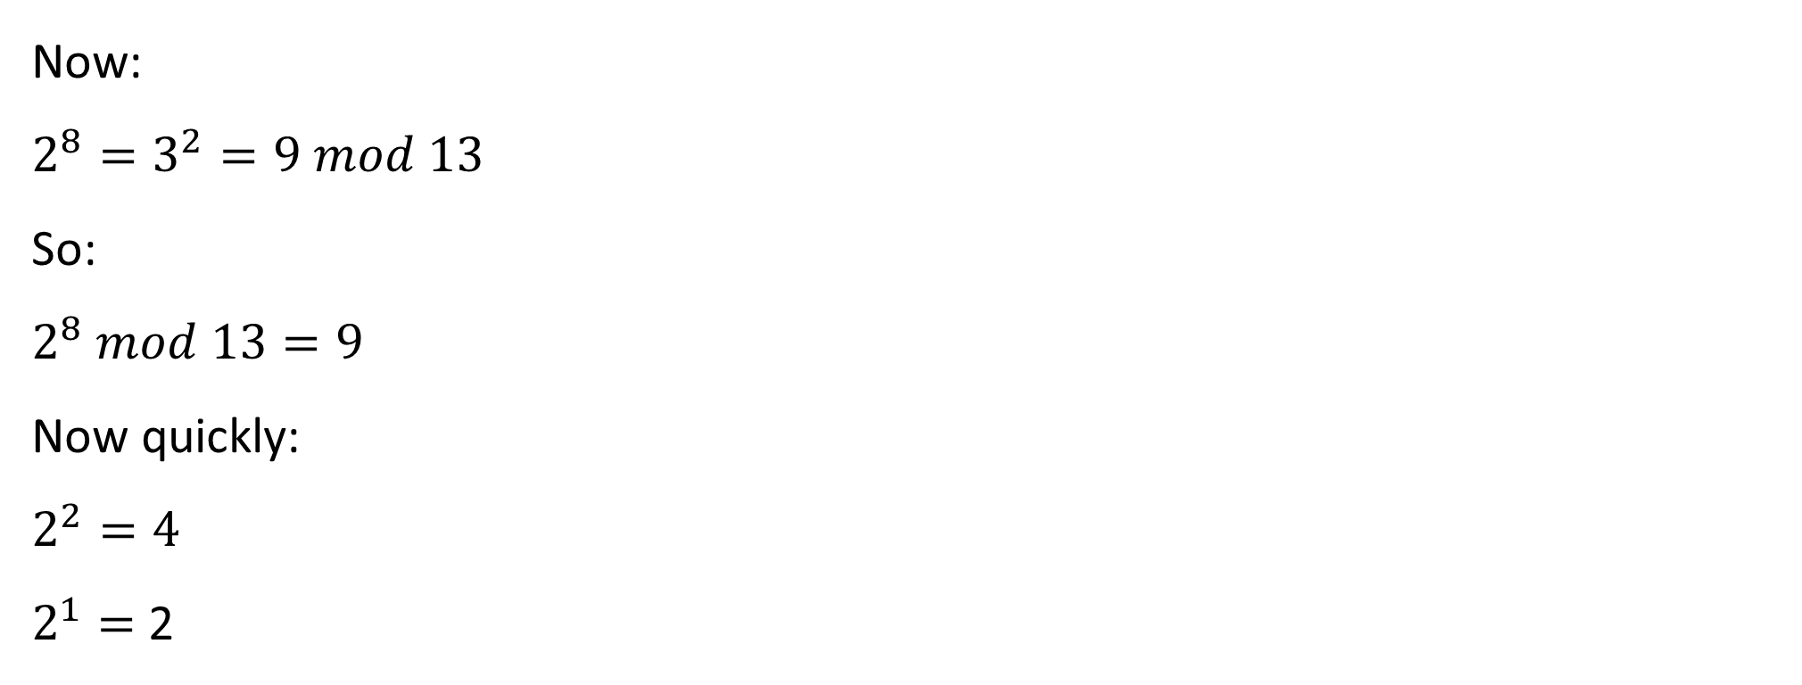
Lab 4 Structure and Step-by-Step Instructions
Now:
$2^{8}=3^{2}=9 mod 13$
So:
$2^{8} mod 13=9$
Now quickly:
$2^{2}=4$
$2^{1}=$ 2

Slide 28
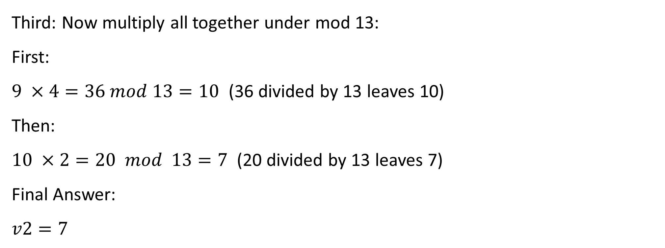
Lab 4 Structure and Step-by-Step Instructions
Third: Now multiply all together under mod 13:
First:
$9 ×4=36 mod 13=10$ (36 divided by 13 leaves 10)
Then:
$10 ×2=20 mod 13=7$ (20 divided by 13 leaves 7)
Final Answer:
$v2=7$

Slide 29
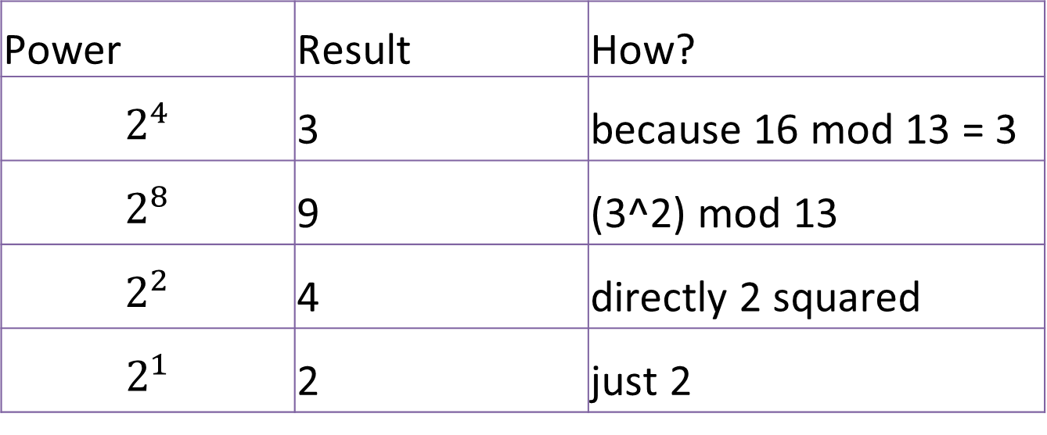
Lab 4 Structure and Step-by-Step Instructions
Quick Summary Table
Power | Result | How?
$$2^{4}$$ | 3 | because 16 mod 13 = 3
$$2^{8}$$ | 9 | (3^2) mod 13
$$2^{2}$$ | 4 | directly 2 squared
$$2^{1}$$ | 2 | just 2

Slide 30
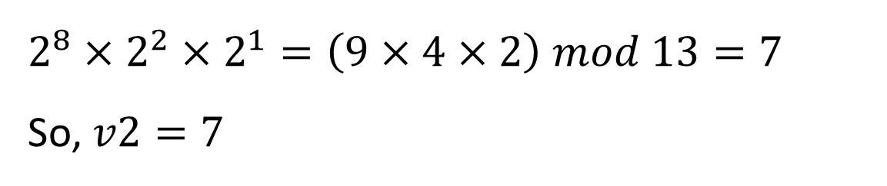
Lab 4 Structure and Step-by-Step Instructions
Final
$$2^{8}×2^{2}×2^{1}=\left(9×4×2\right) mod 13=7$$
So, $v2=7$
Break powers into small ones
Do mod early for each
Multiply small results and mod again

Slide 31
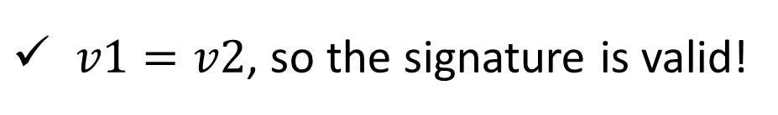
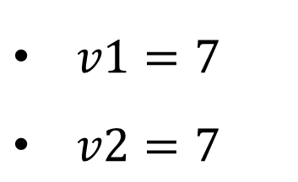
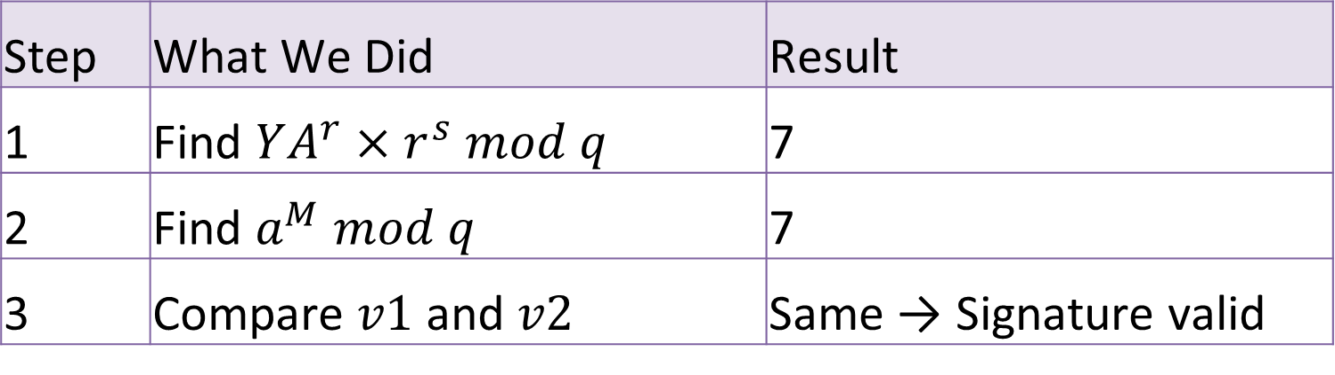
Lab 4 Structure and Step-by-Step Instructions
Final Check
$v1=7$
$v2=7$
$v1=v2$, so the signature is valid!
Quick Summary:
Step | What We Did | Result
1 | Find $YA^{r}×r^{s} mod q$ | 7
2 | Find $a^{M} mod q$ | 7
3 | Compare $v1$ and $v2$ | Same → Signature valid

Slide 32
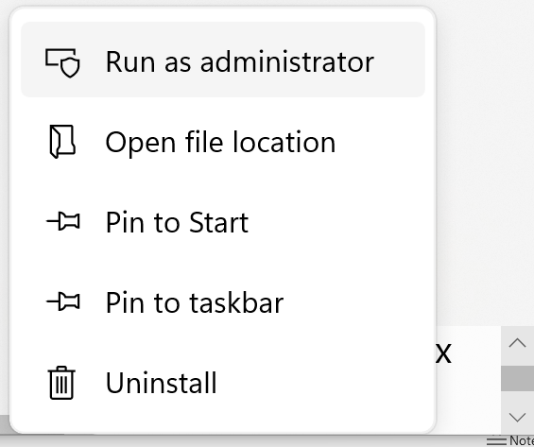
Lab 4 Structure and Step-by-Step Instructions
Part 3: Hashing with OpenSSL in Kali Linux
Goal: See how even tiny changes to a file completely change its fingerprint!
Step 1: Open Oracle VirtualBox Manager and select Kali virtual machine (Kali)
Click on Start → We plan to turn on Kali Linux, and get to the Kali login screen or desktop

Slide 33
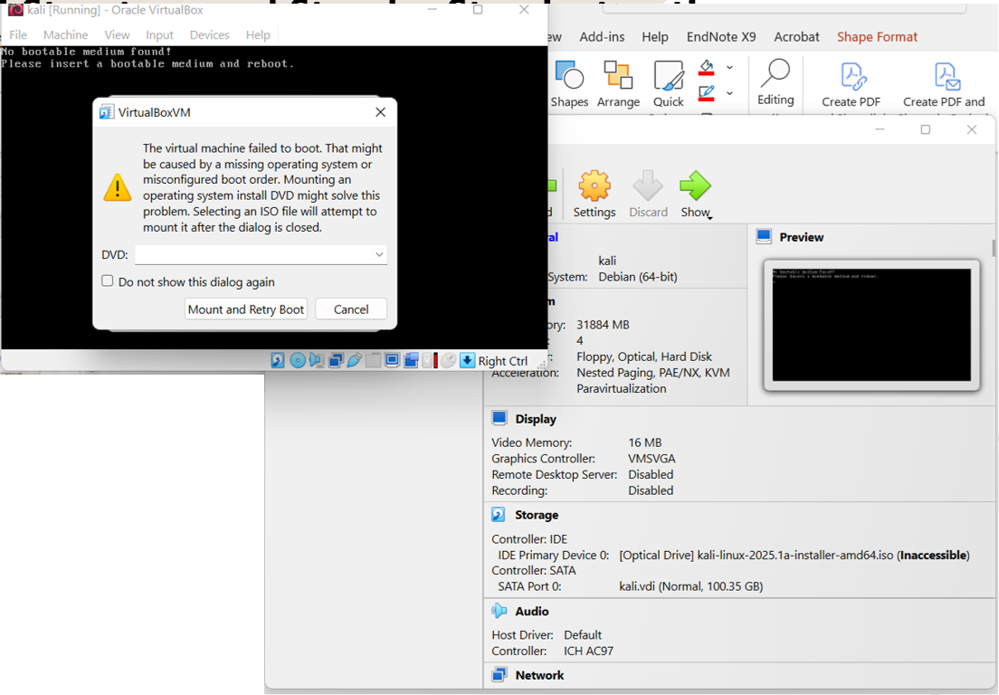
Lab 4 Structure and Step-by-Step Instructions
If the ISO file is corrupted, download a fresh ISO file from Kali.org

Slide 34
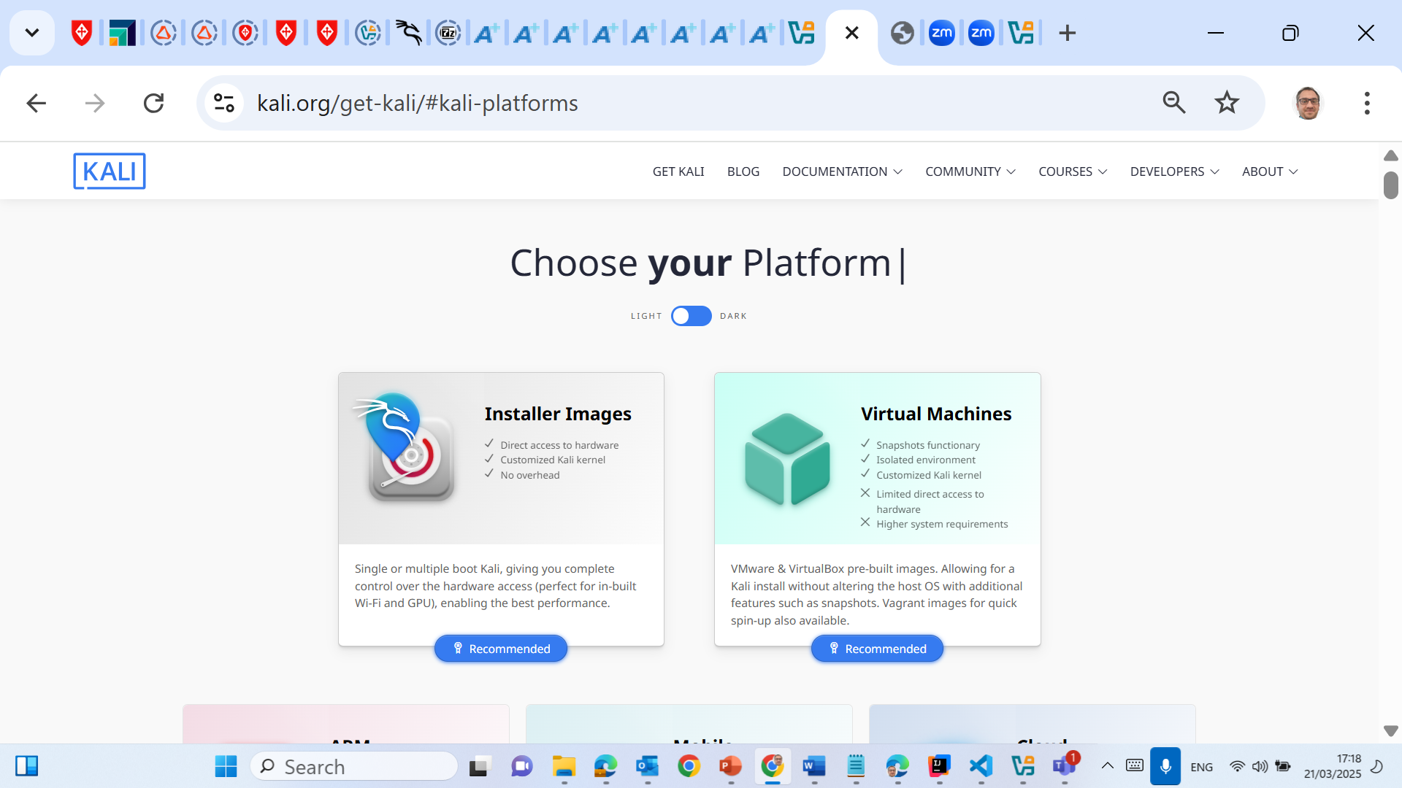
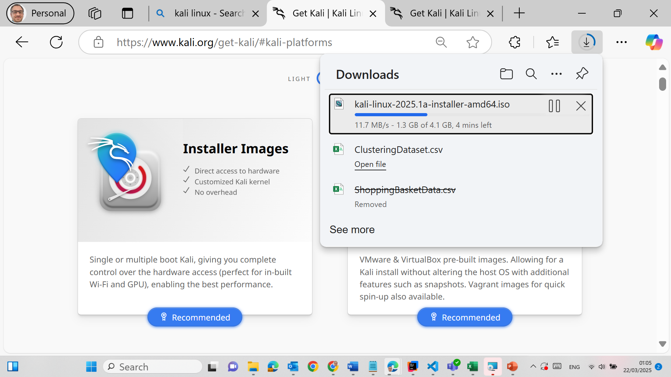
Lab 4 Structure and Step-by-Step Instructions
Remember during Lab 2, we downloaded Kali Linux from (64-bit ISO file)
https://www.kali.org/get-kali/#kali-platforms

Slide 35
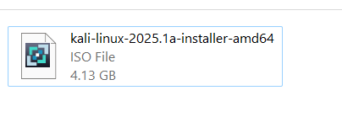
Lab 4 Structure and Step-by-Step Instructions
Remember during Lab 2, we downloaded Kali Linux from (64-bit ISO file)
https://www.kali.org/get-kali/#kali-platforms

Slide 36
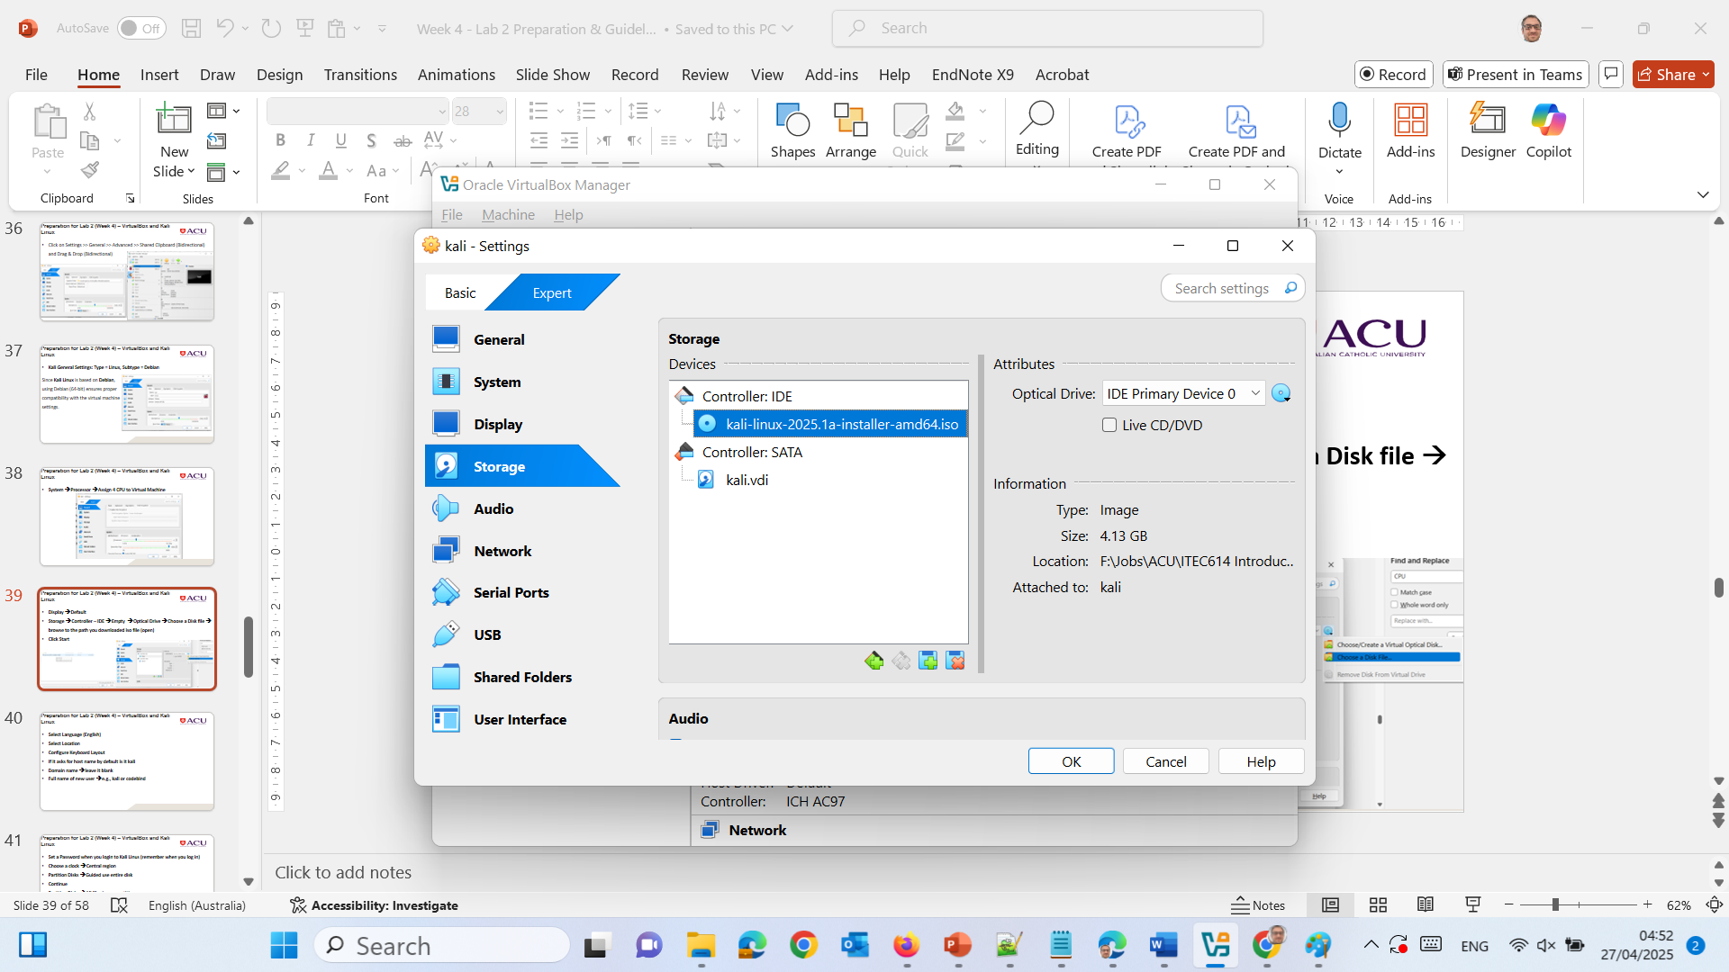
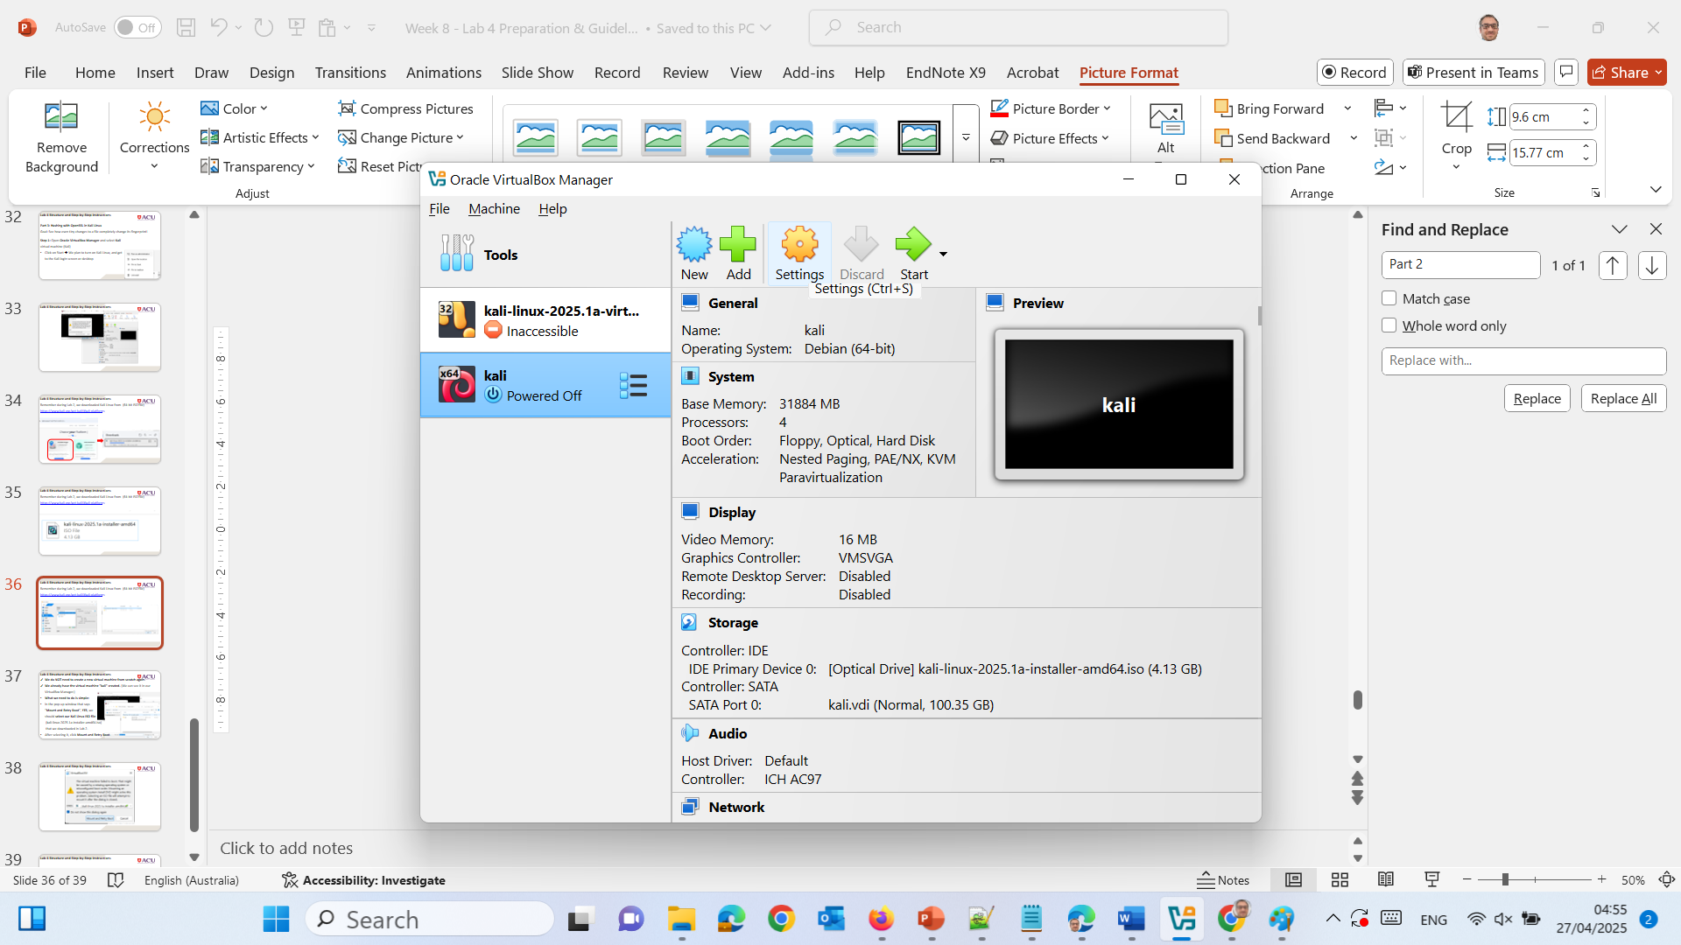
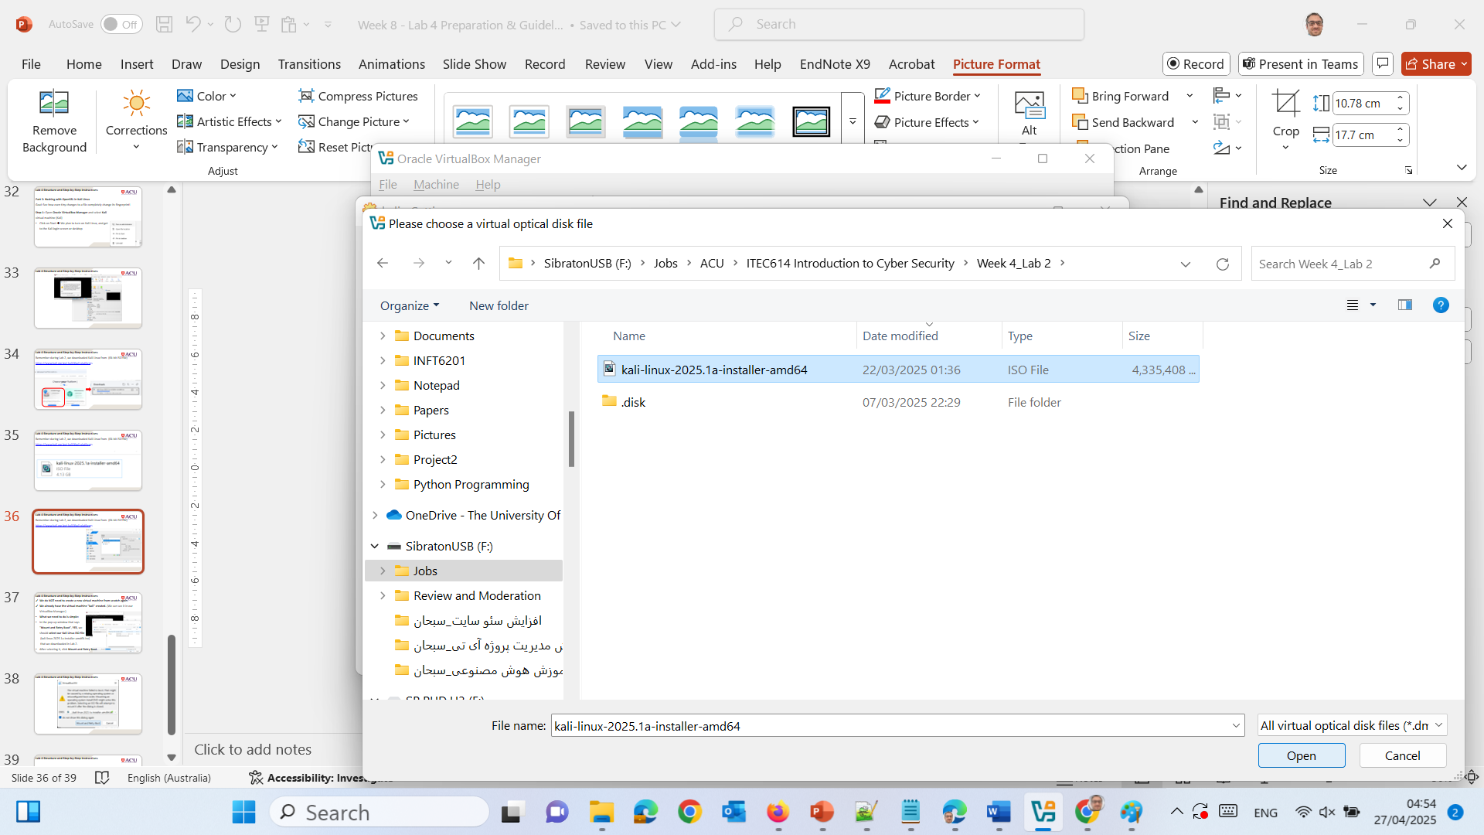

Slide 37
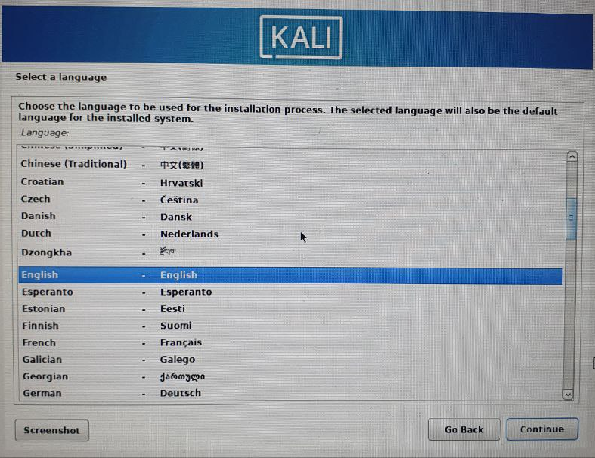
Then we,
selected Language (English)
selected Location
configured Keyboard Layout
If it asks for host name by default is it kali
Domain name → leave it blank
Full name of new user → e.g., kali

Slide 38
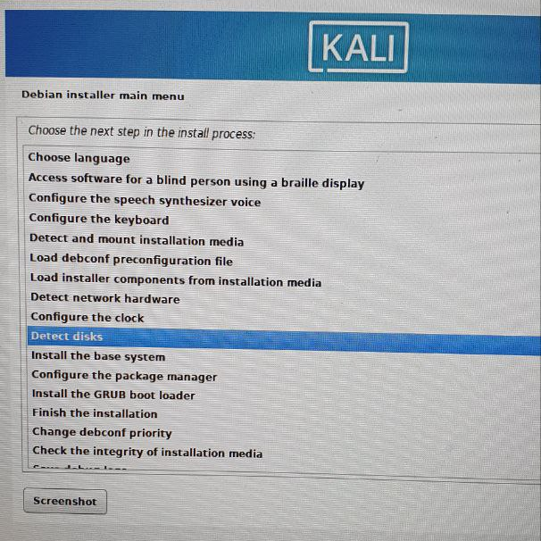
Lab 4 Structure and Step-by-Step Instructions
We selected "Detect disks" → Enter → Continue as installer guides us.
Then "Install the base system".
Then "Configure the package manager".
Then "Install the GRUB boot loader".
Then "Finish the installation".

Slide 39
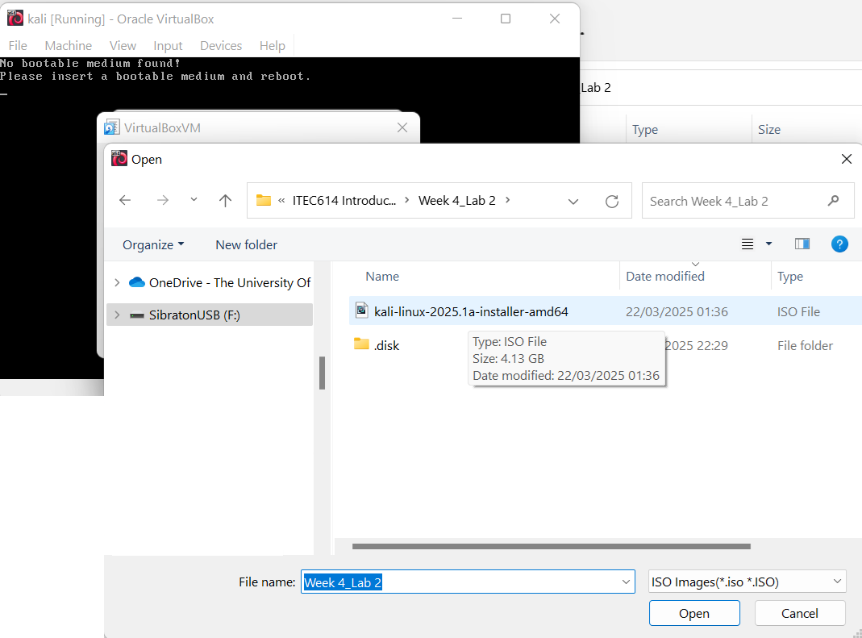
Lab 4 Structure and Step-by-Step Instructions
We do NOT need to create a new virtual machine from scratch again.
We already have the virtual machine "kali" created. (We can see it in our VirtualBox Manager.)
What we need to do is simple:
In the pop-up window that says "Mount and Retry Boot", YES, we should select our Kali Linux ISO file (kali-linux-2025.1a-installer-amd64.iso) that we downloaded in Lab 2.
After selecting it, click Mount and Retry Boot.

Slide 40
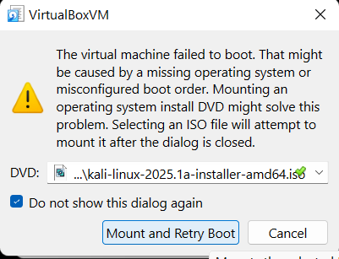
Lab 4 Structure and Step-by-Step Instructions

Slide 41
Lab 4 Structure and Step-by-Step Instructions
Step 2: Create a text file
Name it: student_id.txt
Add the provided text (about hash functions).
Save it in the home directory.
Hash functions are cryptopgraphic algorithms that input messages to generate a fixedsize and unique string output (the hash). Hash functions are characterized by their speed of computations
and difficulty of reversibility. It is usually used to verify whether a message in transit
or in storage has been modified or not because even the smallest change done to the input
data yields a completely different hash. In this lab, we use OpenSSL to generate and verify hashes,
other tool are available.
Step 3: Open Terminal.

Slide 42
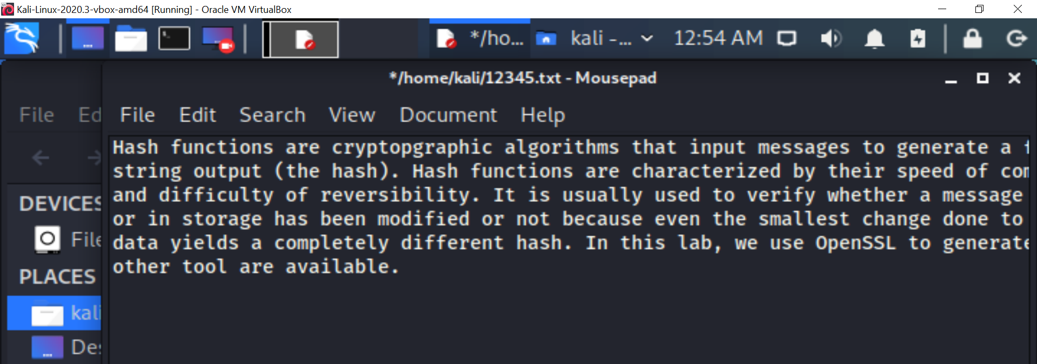
Lab 4 Structure and Step-by-Step Instructions
Step 4: Check file contents
Type cat student_id.txt to check the contents of the student_id.txt file.

Slide 43

Lab 4 Structure and Step-by-Step Instructions
Hash the text file using MD5 hashing algorithm to generate a hash of the text file. Use the command openssl md5 student_id.txt
Observe the output on your screen. What did you observe?
Modify the text file by changing the first “Hash functions” to “Integrity algorithms” and then save.

Slide 44

Recalculate the MD5 hash similar to step 6.
Observe the output. What did you observe? Is the new hash different than you got in step 7? How?
SHA-1 and SHA-2 algorithms are stronger that MD5 hashes. Generate SHA-1 has of the file using openssl sha1 student_id.txt. Observe the output of the algorithm. What did you observe?
Use google to explore the families of SHA-2. How do you compare the strength of SHA-2 compared to SHA-1?

